Slide 1
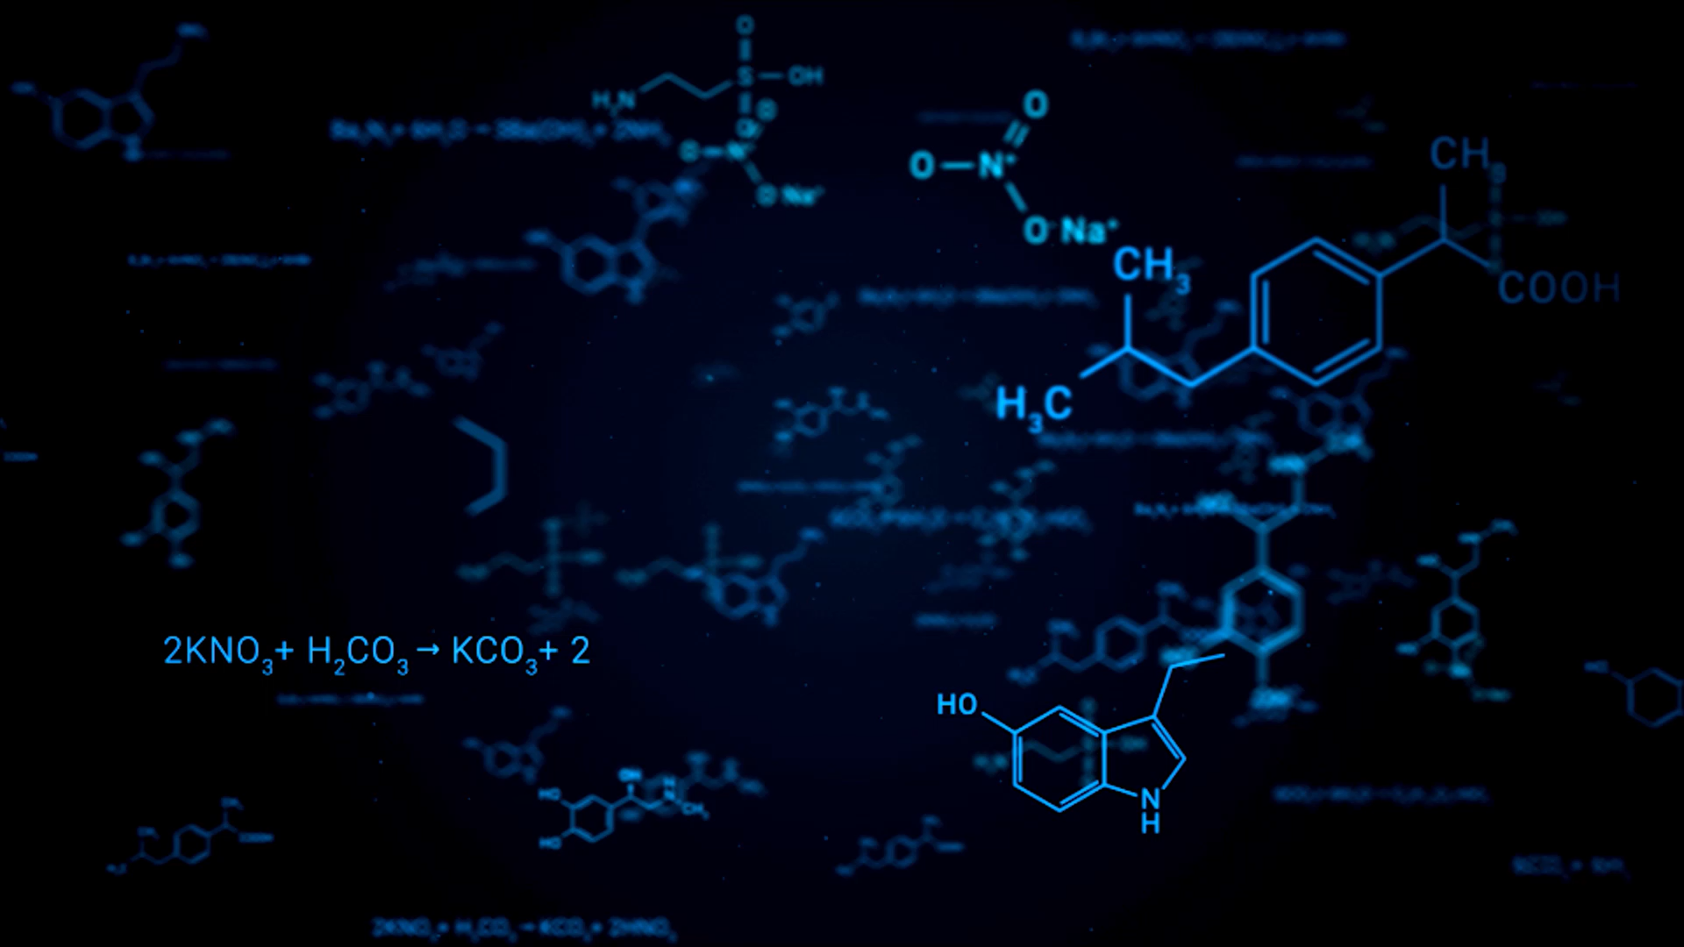
Use of Photoresist Patterning for Application to DNA Sequencing
By:
Christian Saby
Research Advisor:
Jonathan Sokolov

Slide 2
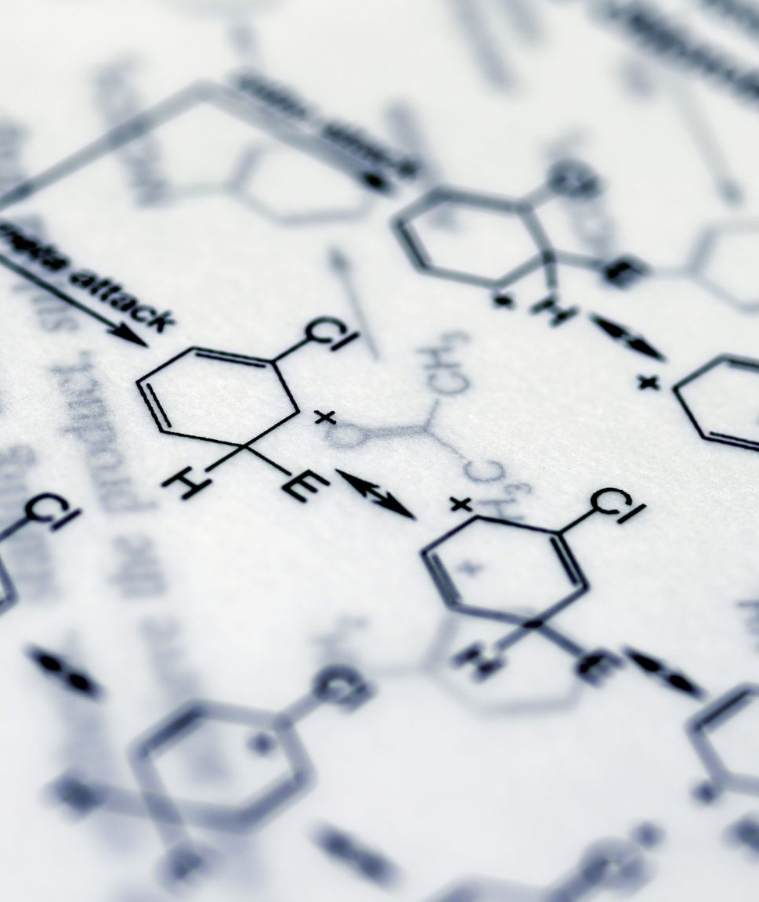
Introduction/Background
DNA Sequencing is a technique to determine the order of nucleotides in a DNA molecule. The order is important because it determines cell function and development[1].
The main goal of our research is to simplify the DNA sequencing process. Conventional methods of cutting DNA have used either random cutting by sonication[2] or using restriction enzymes[3]. This yields many small sequences that must be put back together.
We want to simplify this process by cutting DNA fragments in a controlled manner such that fragments from known locations can be removed and sequenced separately.

Slide 3
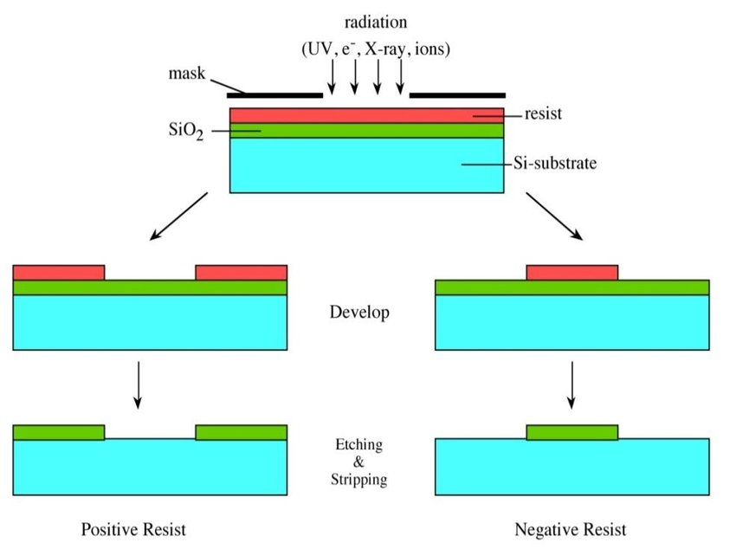
Photoresist
We deposited mouse DNA on pieces of Si wafers coated with SU-8[4]. SU-8 is a negative photoresist that when hit with near-UV light(350-400 nm) causes cross-linking of the polymer chains.
It becomes insoluble in its developer(PGMEA)[5] where cross-linked and it’s this property that allows us to make a pattern out of it. The pattern was made with 2000 mesh TEM grids[6] so that where of the UV(360 nm) is blocked, the SU-8 can be dissolved when immersed in the developer.
These DNA fragments are then cut using microfluidic delivery of DNase I cutting enzyme in such a way that segments from known locations can be removed and sequenced separately.

Slide 4
Why a photoresist?
The DNase I enzyme cutting mechanism involves wrapping around the sugar-phosphate backbone of the DNA strand and cleaving it. This means depositing DNA on a flat surface will not allow the enzyme to wrap around the binding sites.
The idea was to apply the photoresist on the Si surface, deposit the DNA, and expose the resist to make a pattern so that the DNA is suspended across the surface. This way the cutting enzyme has space to bind to the backbone and cleave the DNA.

Slide 5
The problem/Overview
Problem: How long should be expose the sample to UV?
Solution: Use numerical methods(Curve Fitting and Minimization) to create a formula that relates LED current to exposure time.
Plot the V vs. I data and apply a logarithmic fit to get an equation for V(I).
Find the area of the UV beam spot at certain heights above the sample.
Use P=V(I)*I to find an equation for P(I)
Divide this equation by the area to get UV Intensity[7] as a function of current.
Use the UV Dose equation[8] to get a function for exposure time in terms of current.
Minimize the function to find a range of minimum exposure times for the UV at different heights above the sample and compare to the general recommended exposure time.

Slide 6
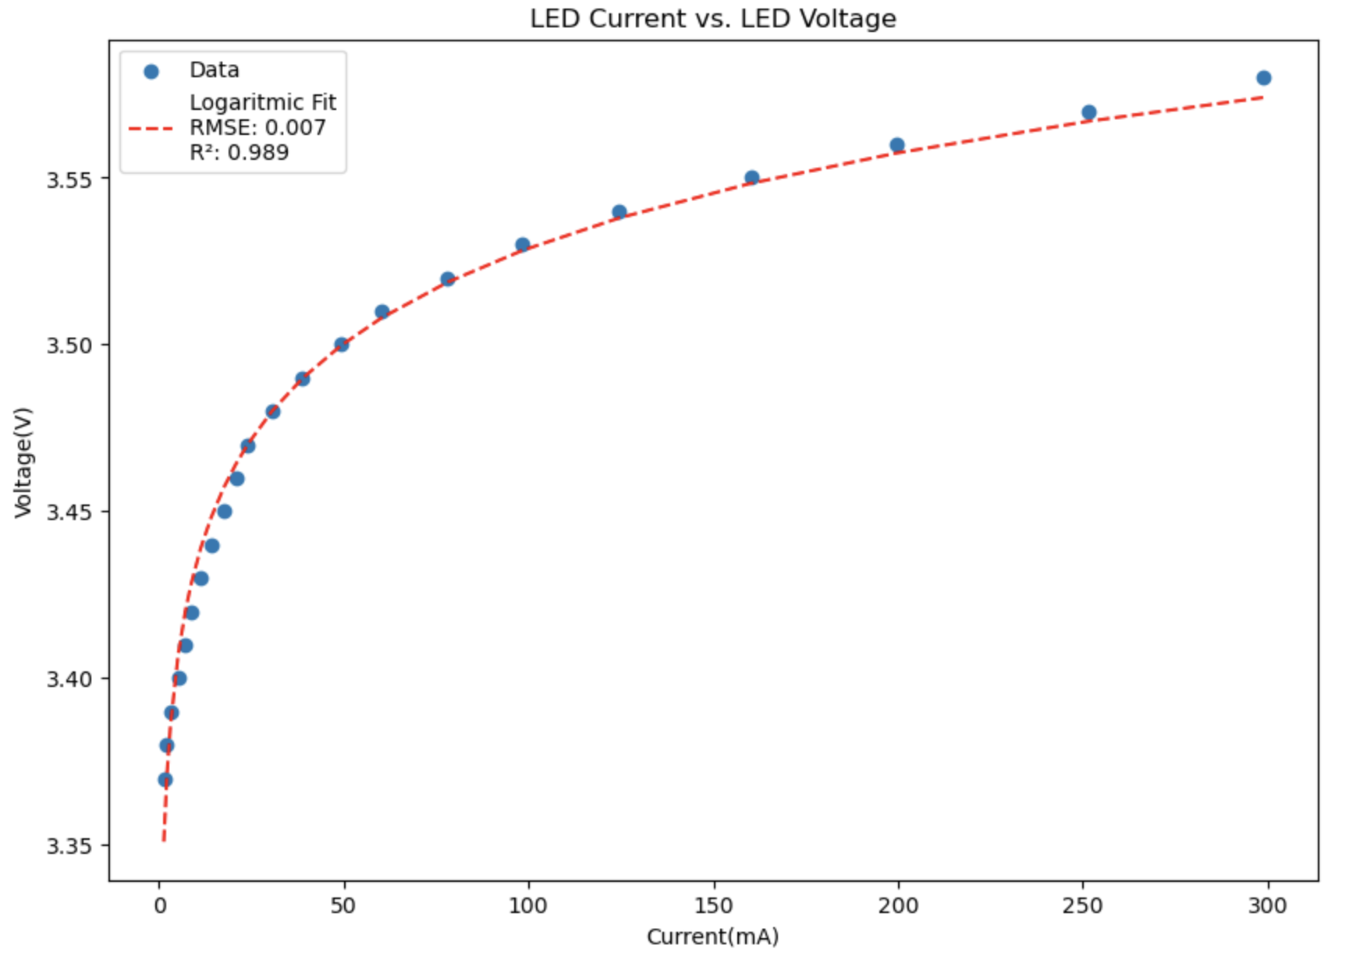
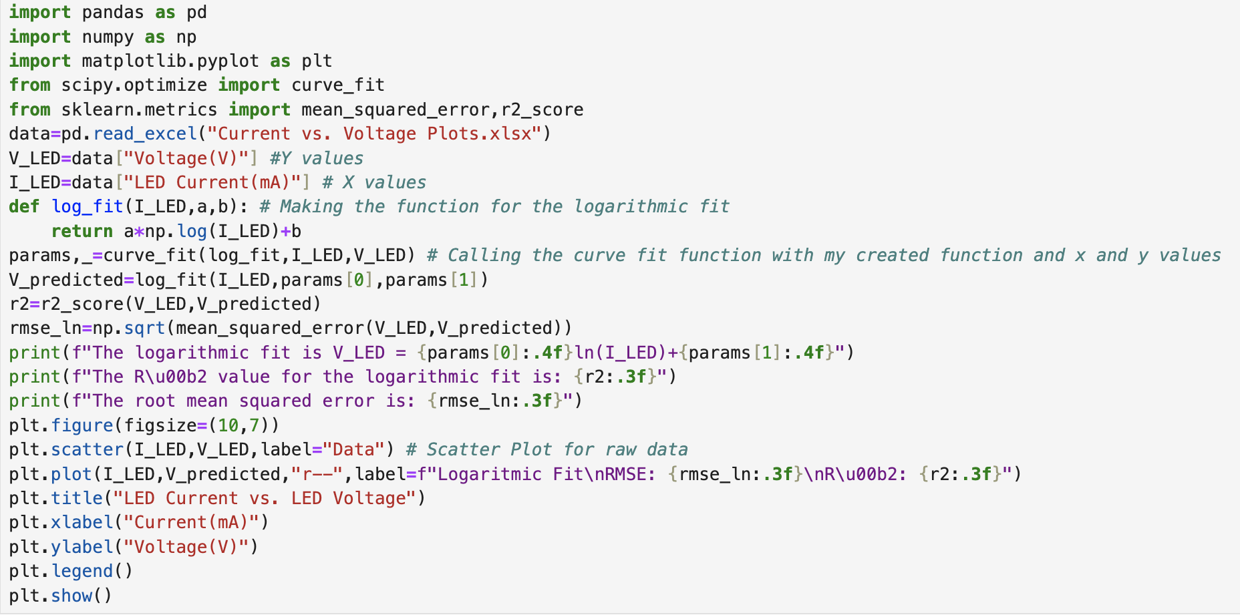
Log Fitting
Equation:
V_{LED}= 0.04125ln(I_{LED})+3.3389
RMSE= 0.007
R²=0.989

Slide 7
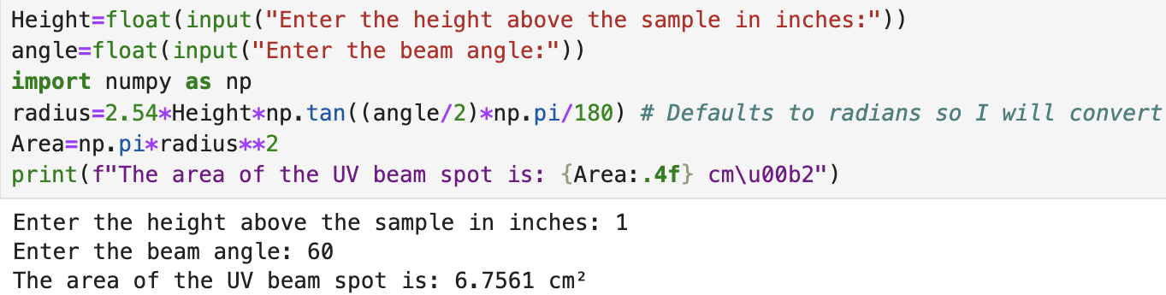
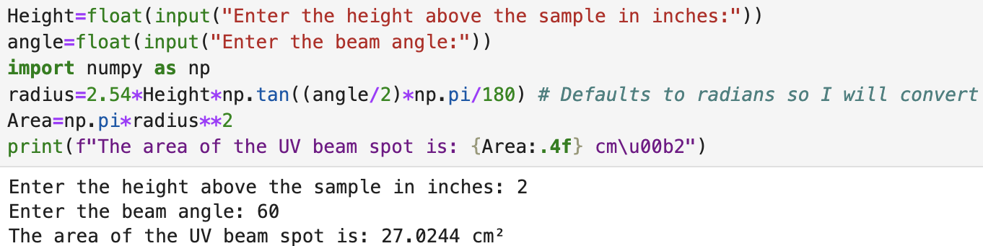
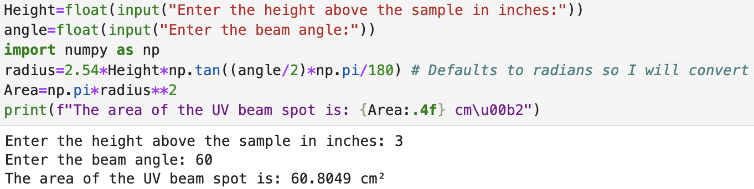
Area of uv beam spot
I estimated the area by using the height of the LED above the sample, the angle of the beam, and used some trig to find the radius(base of the right triangle that bisects the beam).

Slide 8
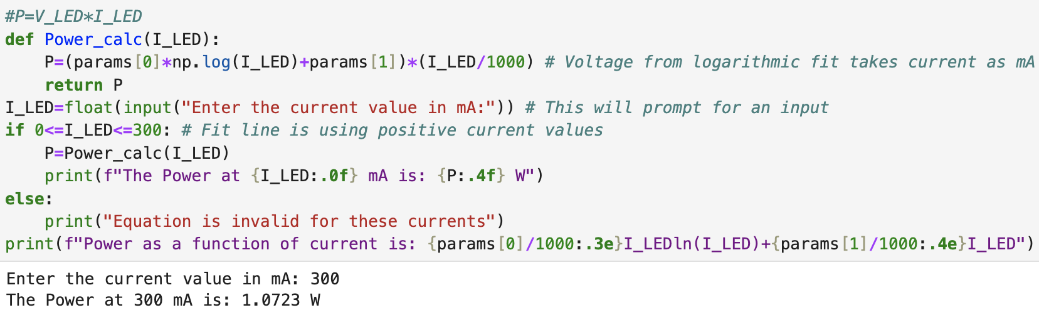
Calculating power & P(I_{LED})
Equation: 1 W=1 J/s=1000 mJ/s
P(I_{LED})=4.125x10⁻⁵I_{LED}ln(I_{LED})+3.3389x10⁻³I_{LED} (in units of W)
P(I_{LED})=0.04125I_{LED}ln(I_{LED})+3.3389I_{LED} (in units of mJ/s)

Slide 9
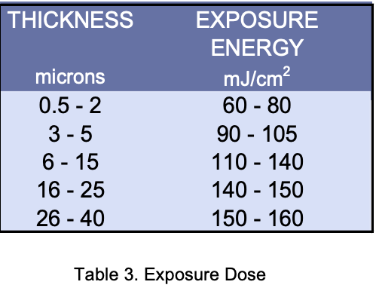
Exposure energy(uv dose)[9]

Slide 10
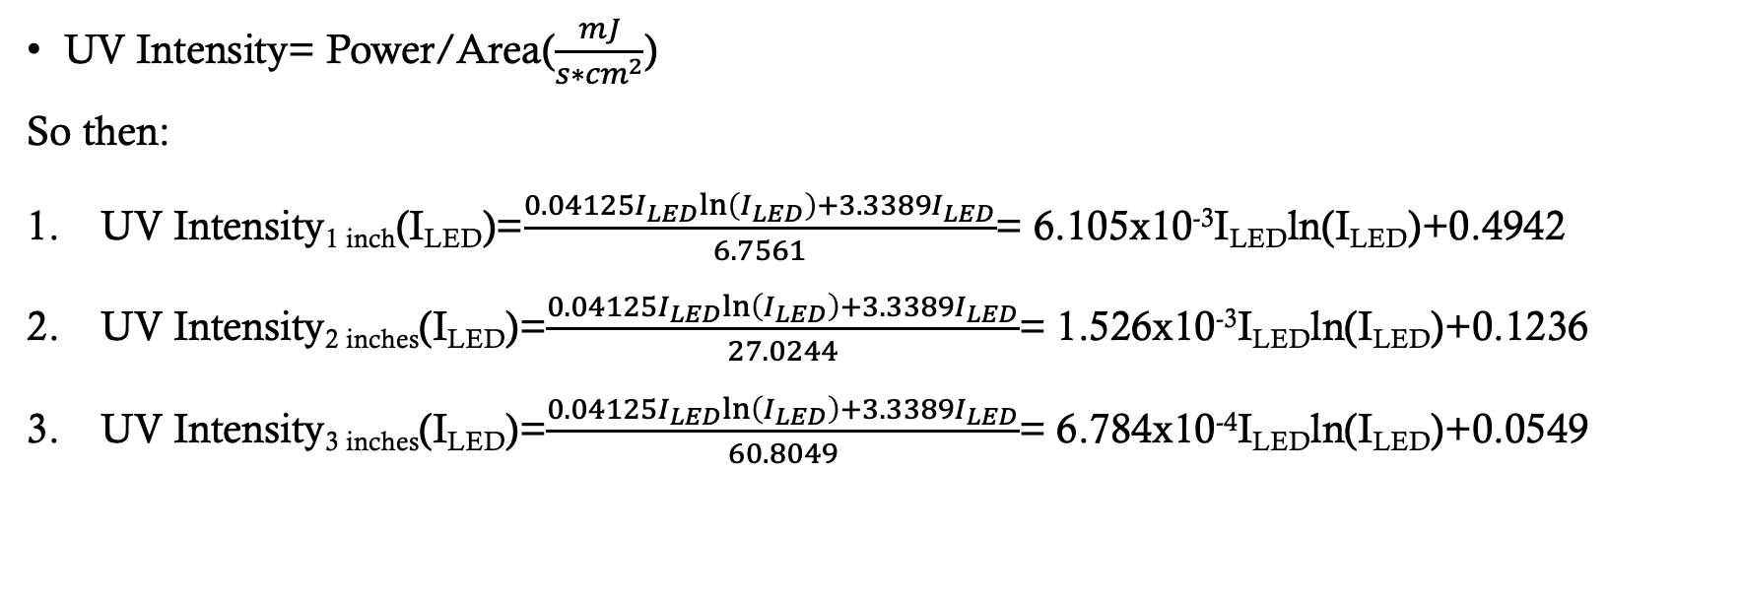
UV Intensity functions
UV Intensity= Power/Area($\frac{mJ}{s∗{cm}^{2}}$)
So then:
UV Intensity_{1 inch}(I_{LED})=$\frac{0.04125I_{LED}ln\left(I_{LED}\right)+3.3389I_{LED}}{6.7561}$= 6.105x10⁻³I_{LED}ln(I_{LED})+0.4942
UV Intensity_{2 inches}(I_{LED})=$\frac{0.04125I_{LED}ln\left(I_{LED}\right)+3.3389I_{LED}}{27.0244}$= 1.526x10⁻³I_{LED}ln(I_{LED})+0.1236
UV Intensity_{3 inches}(I_{LED})=$\frac{0.04125I_{LED}ln\left(I_{LED}\right)+3.3389I_{LED}}{60.8049}$= 6.784x10⁻⁴I_{LED}ln(I_{LED})+0.0549

Slide 11
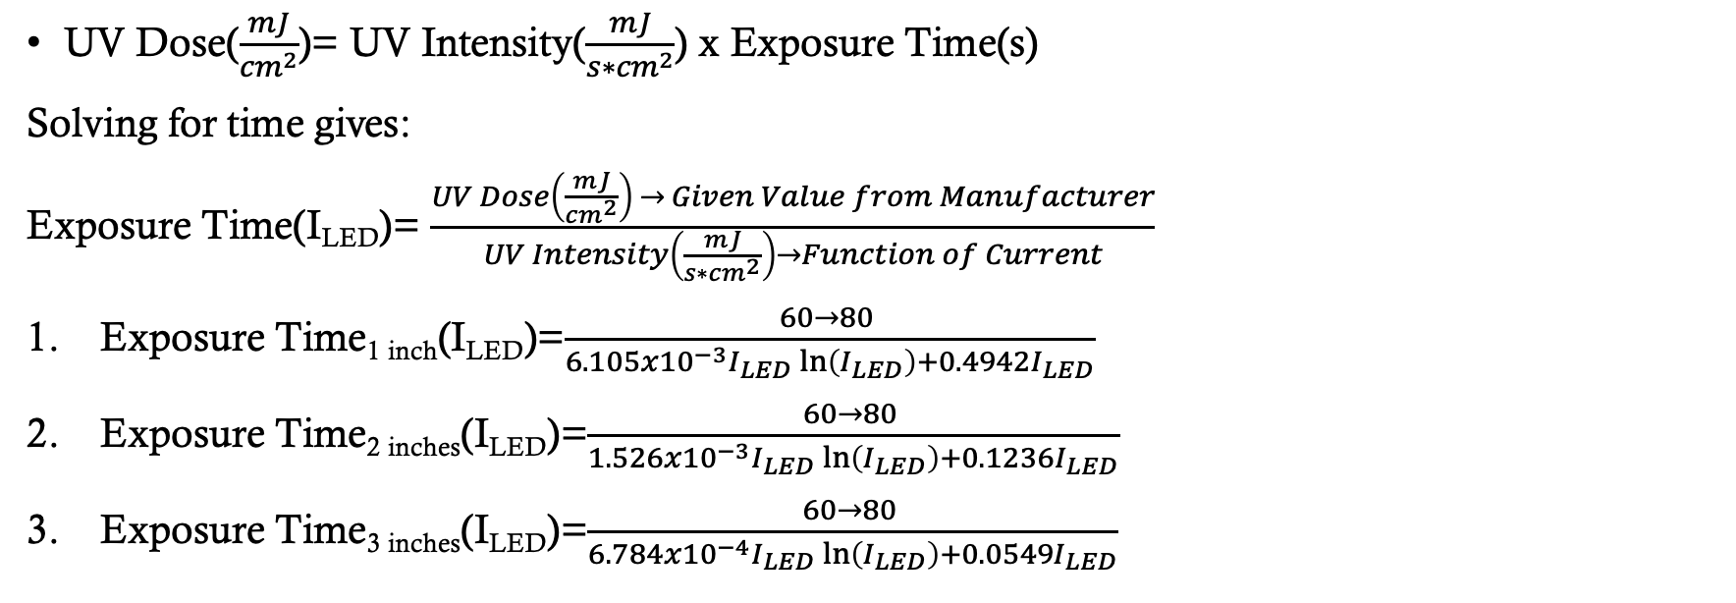
Exposure Time Functions
UV Dose($\frac{mJ}{{cm}^{2}}$)= UV Intensity($\frac{mJ}{s∗{cm}^{2}}$) x Exposure Time(s)
Solving for time gives:
Exposure Time(I_{LED})= $\frac{UV Dose\left(\frac{mJ}{{cm}^{2}}\right) → Given Value from Manufacturer}{UV Intensity\left(\frac{mJ}{s∗{cm}^{2}}\right)→Function of Current}$
Exposure Time_{1 inch}(I_{LED})=$\frac{60→80 }{6.105x{10}^{−3}I_{LED}\ln\left(I_{LED}\right)+0.4942I_{LED}}$
Exposure Time_{2 inches}(I_{LED})=$\frac{60→80 }{1.526x{10}^{−3}I_{LED}\ln\left(I_{LED}\right)+0.1236I_{LED}}$
Exposure Time_{3 inches}(I_{LED})=$\frac{60→80 }{6.784x{10}^{−4}I_{LED}\ln\left(I_{LED}\right)+0.0549I_{LED}}$

Slide 12
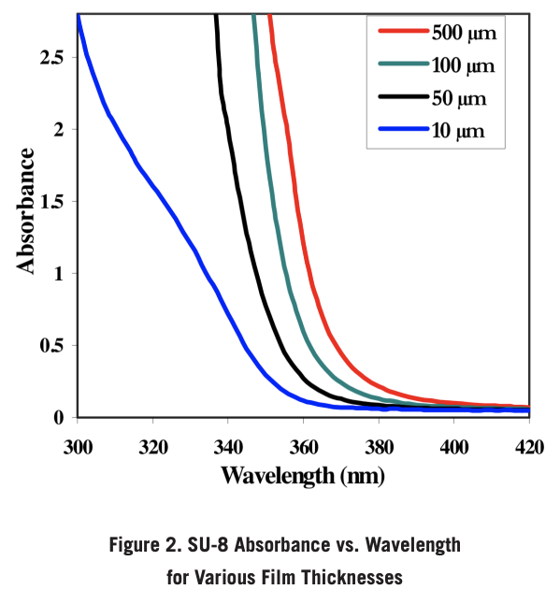
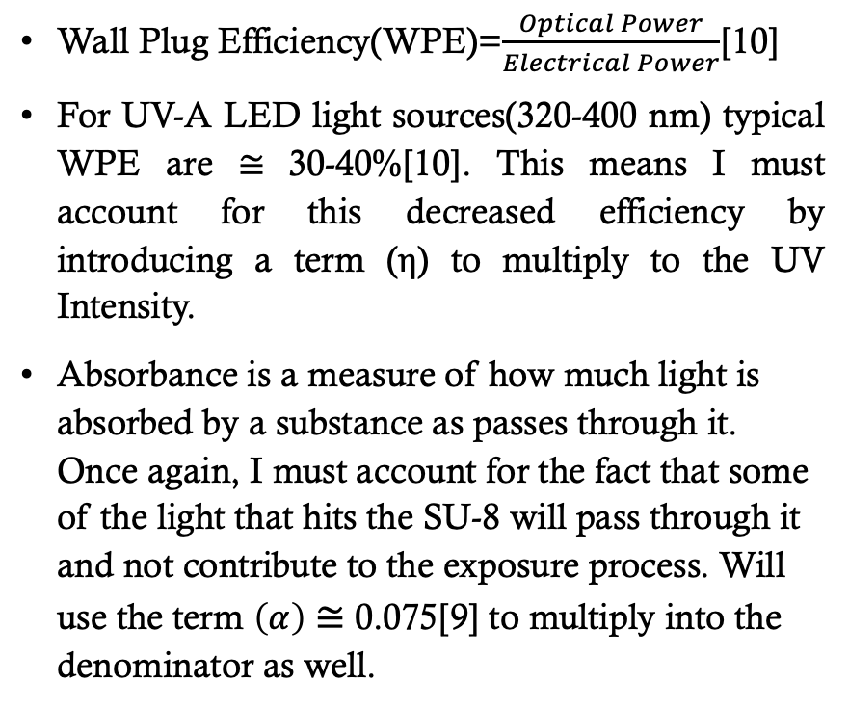
Accounting for wpe & absorbance
Wall Plug Efficiency(WPE)=$\frac{Optical Power}{Electrical Power}$[10]
For UV-A LED light sources(320-400 nm) typical WPE are ≅ 30-40%[10]. This means I must account for this decreased efficiency by introducing a term (η) to multiply to the UV Intensity.
Absorbance is a measure of how much light is absorbed by a substance as passes through it. Once again, I must account for the fact that some of the light that hits the SU-8 will pass through it and not contribute to the exposure process. Will use the term $\left(α\right)$ ≅ 0.075[9] to multiply into the denominator as well.

Slide 13
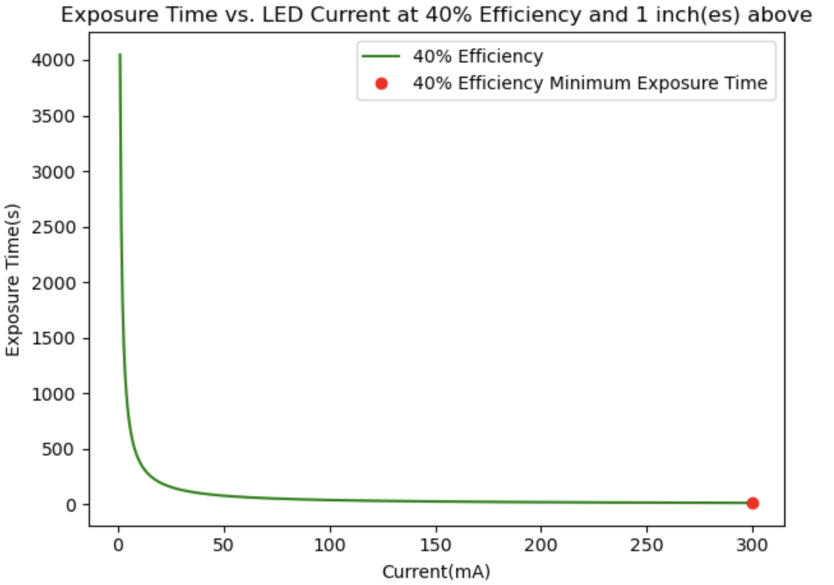
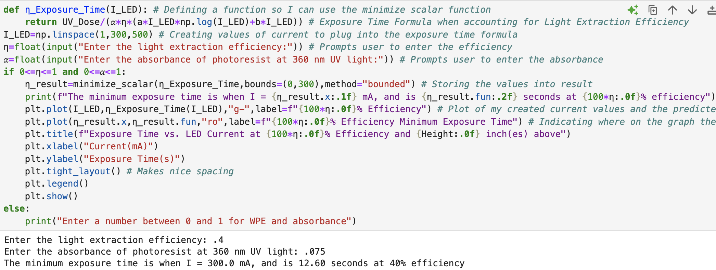
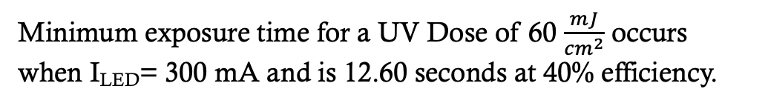
Results i
Minimum exposure time for a UV Dose of 60 $\frac{mJ}{{cm}^{2}}$ occurs when I_{LED}= 300 mA and is 12.60 seconds at 40% efficiency.

Slide 14
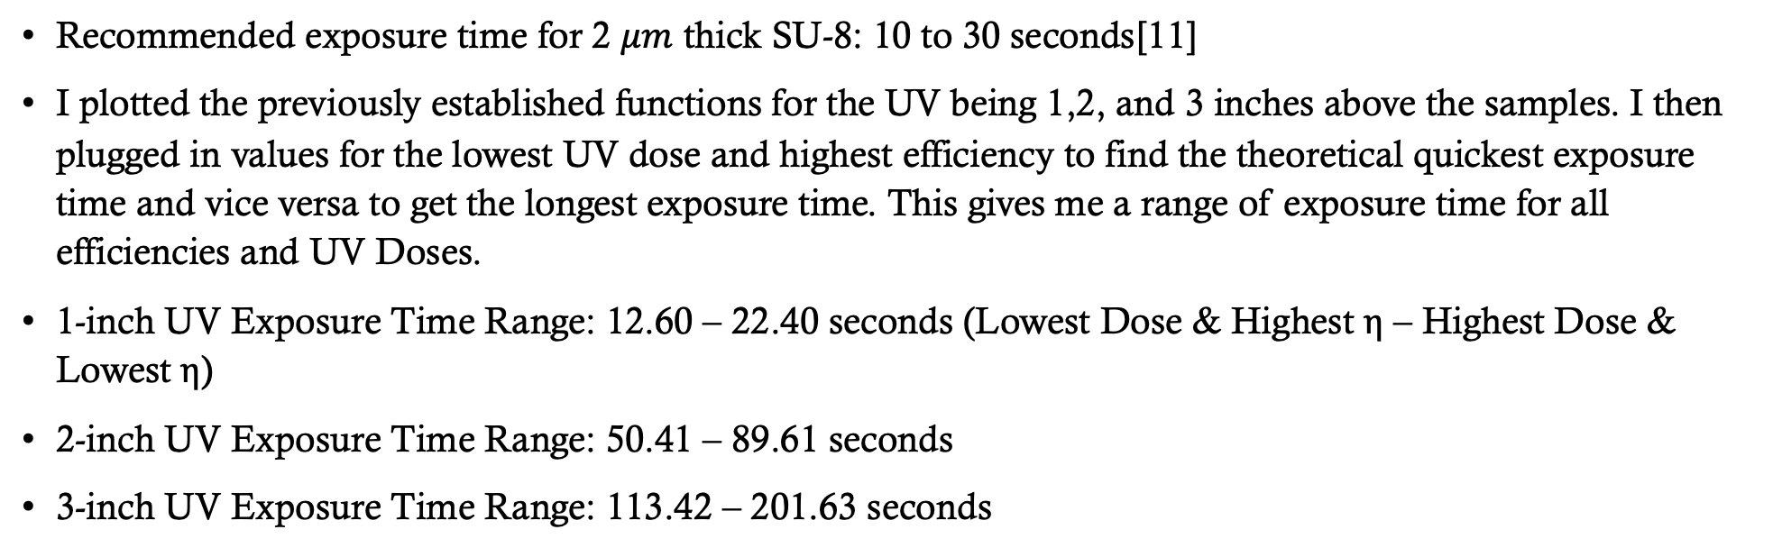
Results ii
Recommended exposure time for 2 $μm$ thick SU-8: 10 to 30 seconds[11]
I plotted the previously established functions for the UV being 1,2, and 3 inches above the samples. I then plugged in values for the lowest UV dose and highest efficiency to find the theoretical quickest exposure time and vice versa to get the longest exposure time. This gives me a range of exposure time for all efficiencies and UV Doses.
1-inch UV Exposure Time Range: 12.60 – 22.40 seconds (Lowest Dose & Highest η – Highest Dose & Lowest η)
2-inch UV Exposure Time Range: 50.41 – 89.61 seconds
3-inch UV Exposure Time Range: 113.42 – 201.63 seconds

Slide 15
Conclusions/Future work
Conclusions:
Made a function that gives me exposure time as a function of current by using curve fitting and minimized it.
Used information from the manufacturer to give me a range of time values to compare to the recommended exposure time.
The UV LED being 1 inch above the sample produces the best results in relation to recommended exposure. The 2 and 3 inch samples are not to be discarded because ranges of exposure time given in literature does not account for every type of UV light or distance from the sample.
The time ranges given should not be seen as absolute. Slightly under or overexposing the sample will not lead to catastrophic results.
Future Works:
Using a spectrophotometer to more directly measure the absorbance of the SU-8 since I had to estimate from information given for thicker samples.
Using a UV light meter to measure UV Intensity. This way I could make a plot of UV Intensity vs. Current directly instead of having to calculate power and then divide by an estimated area. This increases the relative error.
Notes:
Over exposure could lead to wider features than necessary or exaggerated sidewall profiles(T-topping). Under exposure could lead to insufficient cross-linking and thus poor resolution

Slide 16
references
https://www.genome.gov/genetics-glossary/DNA-Sequencing#:~:text=DNA%20sequencing%20refers%20to%20the,use%20to%20develop%20and%20operate.
Sambrook J, Russell DW. Fragmentation of DNA by sonication. CSH Protoc. 2006 Sep 1;2006(4):pdb.prot4538. doi: 10.1101/pdb.prot4538. PMID: 22485919.
Pingoud A, Alves J, Geiger R (1993). "Chapter 8: Restriction Enzymes". In Burrell M (ed.). Enzymes of Molecular Biology. Methods of Molecular Biology. Vol. 16. Totowa, NJ: Humana Press.
https://kayakuam.com/su-8
https://kayakuam.com/products/su-8-developer
https://www.tedpella.com/grids_html/grids.aspx
https://www.linshangtech.com/tech/tech508.html
https://uv-light.co.uk/uv-dose-calculator/
https://kayakuam.com/wp-content/uploads/2019/09/SU-82000DataSheet2000_5thru2015Ver4.pdf
https://www.cisuvc.com/the-role-of-wall-plug-efficiency-in-uvc-led-technology
https://cleanroom.byu.edu/su-8-information-page

Slide 17

questions

